Slide 1


Final
PRESENTATION
Presented By
Md. Al Adnan
ASH1825008M

Slide 2
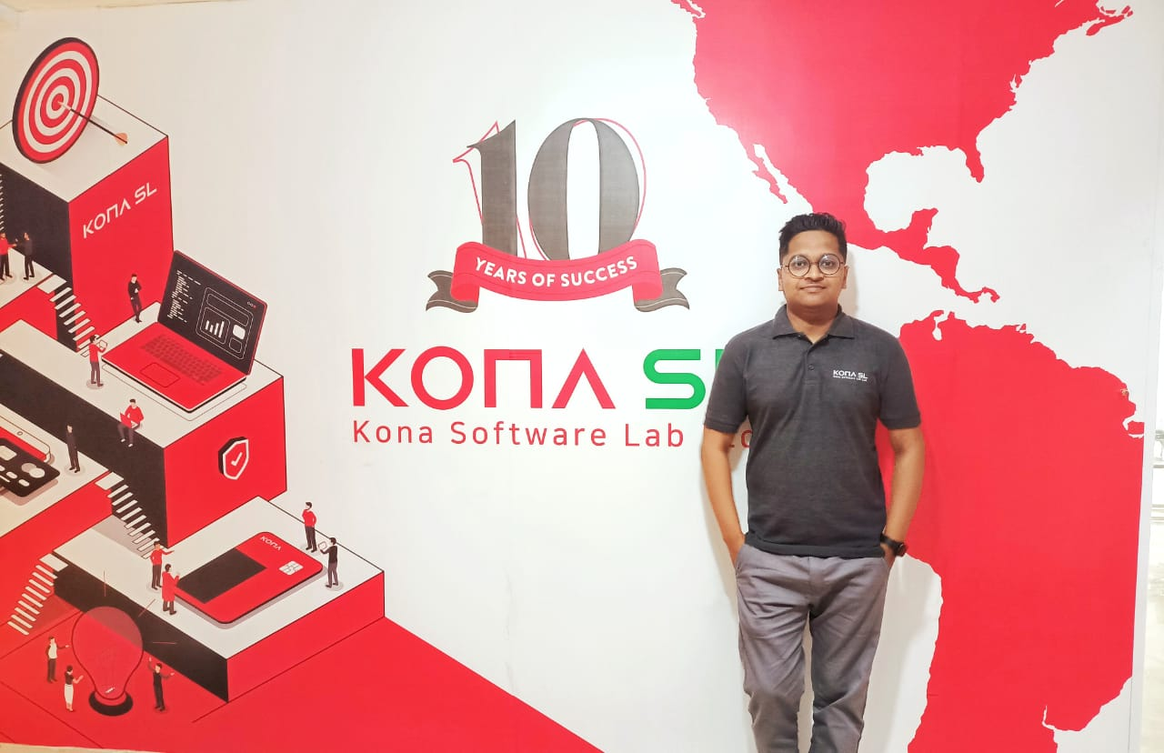
KONA Software Lab Ltd.
Police Plaza Concord, 8th Floor, Tower - A Plot - 2, Road - 144, Dhaka 1212, Bangladesh
Address: https://konasl.com

Slide 3
Overview
KONA I is Korea’s leading FinTech Company that offers a total solution in the areas of payment, authentication, and security. KONA I is the mother company of KONASL
KONA SL established in 2012
KONA SL R&D Center and Global Solution Business Wing of KONA
The notable business solutions are NexusPay and Nagad.
Development areas are:
Smart Card
Digital Payment Solutions
Block chain as service based on Ethereum and Bitcoin.
Secure element based on IoT Security

Slide 4
About KONASL
Kona Software Lab Ltd. marks its 10th year in Bangladesh as R&D Center and Global Solution Business Wing of KONA which has over 20 years of dominant
international presence. Globally, KONA serves 500 customers in 90 countries (ranks among top 4 banking card manufacturers).In Bangladesh,
KONA serves more than 30 banks and owns 50% card market share.

Slide 5

Renowned Clients of the Company
Nagad
Nexuspay
Merchantile
Bank Finnovation
Kona Card
DBBL
City Bank
EBL
IFIC Bank
EXIM Bank
Trust Bank
Jamuna Bank

Slide 6

Rules And Regulations
Office Hour 9am-6pm
Need to add Clokify-Entry
Employee Verification punch

Slide 7

HR Policies
Leave and Time-Off Benefits
Safety and Health
Finding Talent
Employee Data Security
Filling High-Tech Positions
Telecommuting

Slide 8
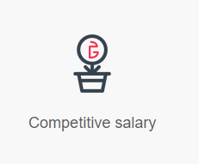
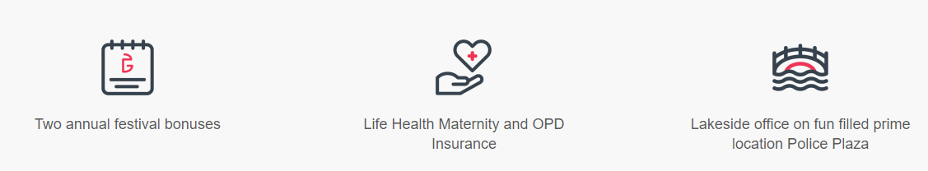
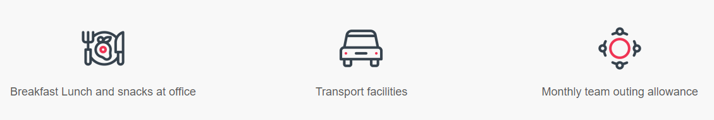
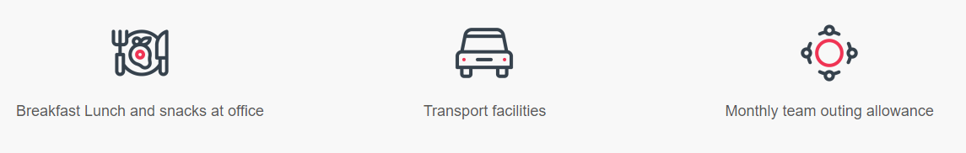
KONASL
Facilities

Slide 9
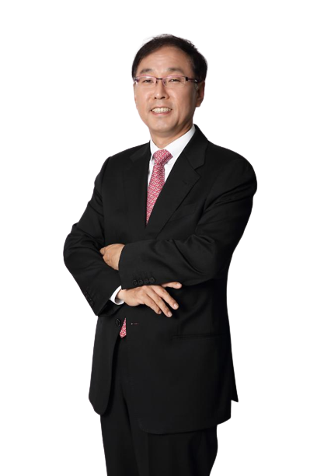
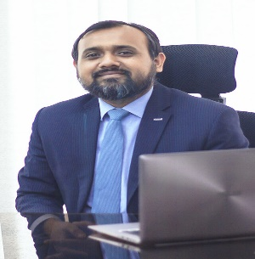
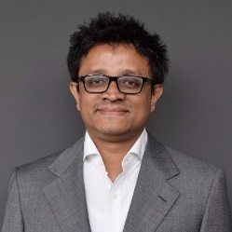
Company Hierarchy
Minaoar Hossain Tanzil
Managing Director, Kona Software Lab Ltd
Cho Chung-il
Topu Newaj
Chairman, Kona Software Lab Ltd.
EVP- Kona Software Lab Ltd
Notes:
https://www.freepik.com/free-photo/businessman-leader-modern-office-with-businesspeople-working_1174193.htm
https://www.freepik.com/free-photo/confident-business-people-diversity-teamwork-concept_17229697.htm

Slide 10
Kona Software Lab Ltd. Organization With Business Unit
Cho Chung-il
Chairman, Kona Software Lab Ltd.
Minaoar Hossain Tanzil
Managing Director, Kona Software Lab Ltd
Aflatun Kaisar
Mohammad Arifur Rahman
Topu Newaj
M. Shahriar Mamun
Abdullah Al Mahmud
Chief of People Care
Director of commercial
EVP
Director of commercial
Sr Manager Admin $ Finence
DFS
Digital Banking Unit
Block Chain
Ecommerce
Fintech
Platform
Business Unit
Business Unit
Business Unit
Business Unit
Business Unit
Business Unit
Md Zulfikhar Rahman
SysOps

Slide 11
Business Unit Structure
Head Of Business
Project Manager
Head of Technology
Business Analyst
Solution Architect
Engineering Manager
Sr.QA
Sr. Developer
Developer
Security Engineer
QA
Test Automation Eng.

Slide 12
Fintech Business Unit
Saifur Islam
Head of Technology
Assign Project
P2P
(Crypto trade)
OPENAPI
Notes:
https://www.freepik.com/free-photo/happy-business-woman-pointing-copyspace_7379048.htm
https://www.freepik.com/free-photo/happy-young-man-using-laptop-computer_8195606.htm
https://www.freepik.com/free-photo/smiling-confident-businesswoman-posing-with-arms-folded_5546285.htm
https://www.freepik.com/free-photo/portrait-handsome-businessman-with-glasses_12232405.htm
https://www.freepik.com/free-photo/confident-stylish-handsome-young-businessman-adjusting-necktie-looking-camera_2788501.htm#page=1&query=business%20man&position=45&from_view=search

Slide 13
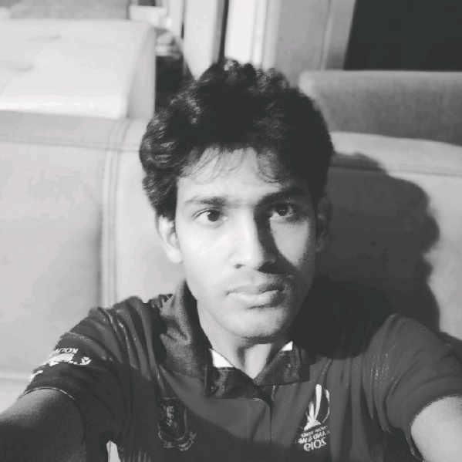
P2P(Crypto-Trade)
Shahidul Islam
( Project Supervisor )
Engineering Manager- KONASL
Lead- P2P Kona Trading System
Notes:
https://www.freepik.com/free-photo/happy-business-woman-pointing-copyspace_7379048.htm
https://www.freepik.com/free-photo/happy-young-man-using-laptop-computer_8195606.htm
https://www.freepik.com/free-photo/smiling-confident-businesswoman-posing-with-arms-folded_5546285.htm
https://www.freepik.com/free-photo/portrait-handsome-businessman-with-glasses_12232405.htm
https://www.freepik.com/free-photo/confident-stylish-handsome-young-businessman-adjusting-necktie-looking-camera_2788501.htm#page=1&query=business%20man&position=45&from_view=search

Slide 14
Assign Project
Project Name - Kona Treading System(Cryptrade) – P2P
Backend- Block Chain, Spring boot
Database- MongoDB, Postgres, Hexlant
Frontend- React
Automation – Selenium , Chrome dev tools
IDE – Intelij IDEA, VS Code ,Postman, JMeter, Gitlab

Slide 15
P2P(Cryptrade)
Project Description : Cryptrade is an online exchange platform where users can trade cryptocurrencies. It supports the most popular cryptocurrencies, such as bitcoin and ethereum. Cryptrade provides a crypto wallet for traders to store their funds. Like other crypto exchanges, Cryptrade offers services like trading, sending coins, and receiving coins. Cryptrade has its own block chain-based token in its development phase, Kona coin.
You job description (role): Software Automation Engineer.
Notes:
https://www.freepik.com/free-photo/happy-business-woman-pointing-copyspace_7379048.htm
https://www.freepik.com/free-photo/happy-young-man-using-laptop-computer_8195606.htm
https://www.freepik.com/free-photo/smiling-confident-businesswoman-posing-with-arms-folded_5546285.htm
https://www.freepik.com/free-photo/portrait-handsome-businessman-with-glasses_12232405.htm
https://www.freepik.com/free-photo/confident-stylish-handsome-young-businessman-adjusting-necktie-looking-camera_2788501.htm#page=1&query=business%20man&position=45&from_view=search

Slide 16
My responsibilities
My daily activities was to improve automation added new automation field as per as developer needed
Writing code for new feature and existing feature so than developer and SQA team can save their time.
Develop three version of automation testing tool.
(General)First of all write Selenium (TestNg) code for running our code in happy path than refactor the code.
(Excel Based)Secondly work with excel sheet automation where sheet are used to perform automation testing.
(Dynamic)Thirdly fully backend project where automation is run by calling api (using postman).
Input: Excel File
Processing Steps: Data aggregator->Build Test Param-> Convert to Object-> Action Processor -> Test Results
Output: Test Results
Here I also worked for load testing and report generating
Notes:
https://www.freepik.com/free-photo/happy-business-woman-pointing-copyspace_7379048.htm
https://www.freepik.com/free-photo/happy-young-man-using-laptop-computer_8195606.htm
https://www.freepik.com/free-photo/smiling-confident-businesswoman-posing-with-arms-folded_5546285.htm
https://www.freepik.com/free-photo/portrait-handsome-businessman-with-glasses_12232405.htm
https://www.freepik.com/free-photo/confident-stylish-handsome-young-businessman-adjusting-necktie-looking-camera_2788501.htm#page=1&query=business%20man&position=45&from_view=search

Slide 17
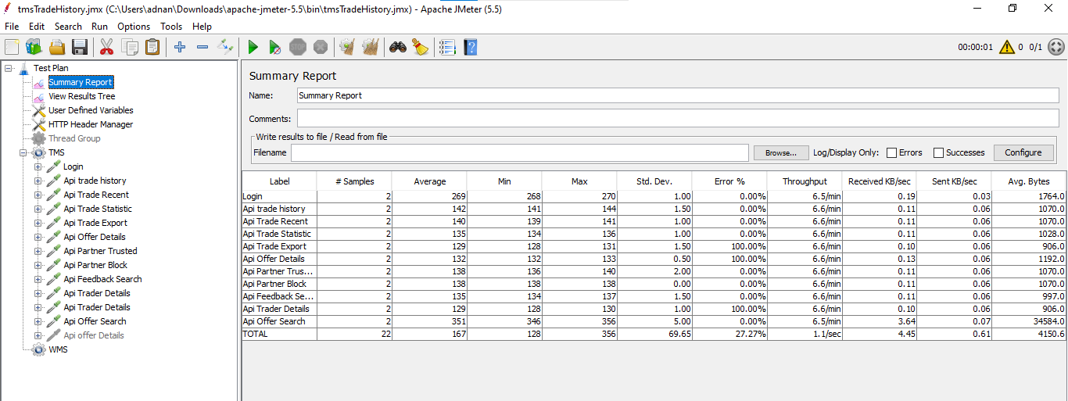
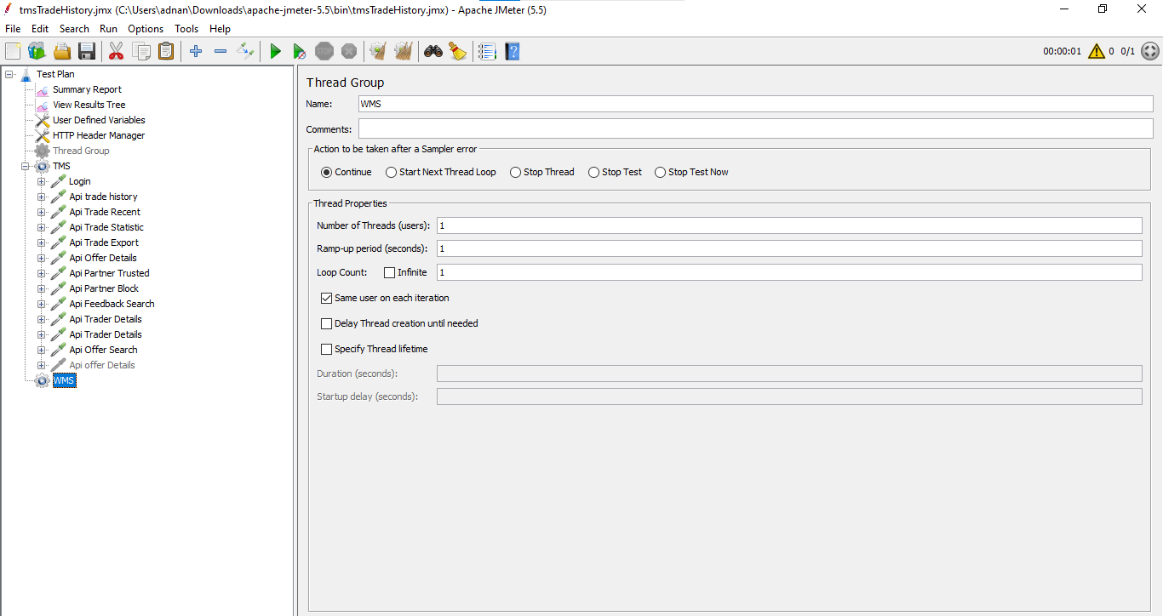
Load Testing in P2P Project
Tools: JMeter 5.5
Techniques : API chaining
Some API
/api/trade/history /api/trade/recent /api/trade/statistic /api/trade/export /api/offer/detail /api/partner/trusted etc..
https://github.com/aladnansami/API-Load-Test-For-Konasl-Project/blob/main/tmsTradeHistory.jmx
Notes:
https://www.freepik.com/free-photo/happy-business-woman-pointing-copyspace_7379048.htm
https://www.freepik.com/free-photo/happy-young-man-using-laptop-computer_8195606.htm
https://www.freepik.com/free-photo/smiling-confident-businesswoman-posing-with-arms-folded_5546285.htm
https://www.freepik.com/free-photo/portrait-handsome-businessman-with-glasses_12232405.htm
https://www.freepik.com/free-photo/confident-stylish-handsome-young-businessman-adjusting-necktie-looking-camera_2788501.htm#page=1&query=business%20man&position=45&from_view=search

Slide 18
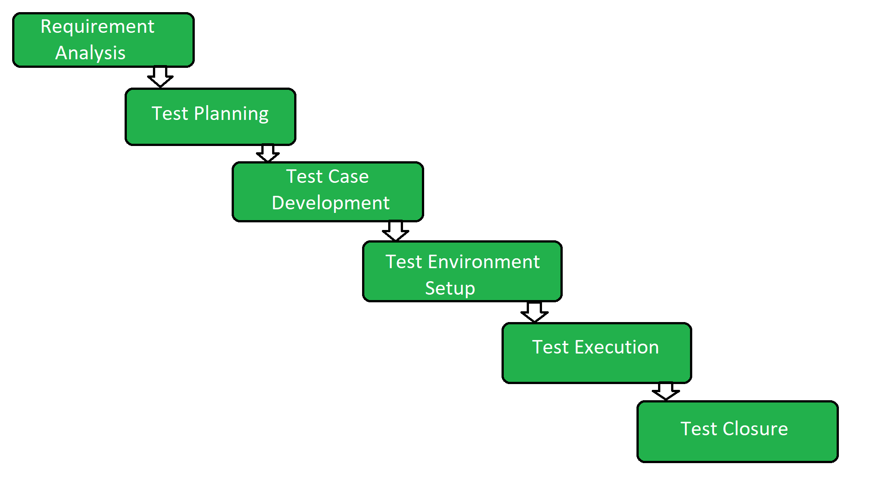
STLC phases I have follow in P2P Project
Notes:
https://www.freepik.com/free-photo/happy-business-woman-pointing-copyspace_7379048.htm
https://www.freepik.com/free-photo/happy-young-man-using-laptop-computer_8195606.htm
https://www.freepik.com/free-photo/smiling-confident-businesswoman-posing-with-arms-folded_5546285.htm
https://www.freepik.com/free-photo/portrait-handsome-businessman-with-glasses_12232405.htm
https://www.freepik.com/free-photo/confident-stylish-handsome-young-businessman-adjusting-necktie-looking-camera_2788501.htm#page=1&query=business%20man&position=45&from_view=search

Slide 19
Communicate and Team Works
Everyday scrum meeting at 9:15 am
Every Two weeks after sprint planning meeting
Any Times Discussion
Checking and Updating about the progress.
Contacting directly or messaging through Slack
Checking the deadline in monthly progress meeting
Notes:
https://www.freepik.com/free-photo/happy-business-woman-pointing-copyspace_7379048.htm
https://www.freepik.com/free-photo/happy-young-man-using-laptop-computer_8195606.htm
https://www.freepik.com/free-photo/smiling-confident-businesswoman-posing-with-arms-folded_5546285.htm
https://www.freepik.com/free-photo/portrait-handsome-businessman-with-glasses_12232405.htm
https://www.freepik.com/free-photo/confident-stylish-handsome-young-businessman-adjusting-necktie-looking-camera_2788501.htm#page=1&query=business%20man&position=45&from_view=search

Slide 20
Technical Challenges
New Framework Learning(Like Spring boot, selenium)
Maintaining large codebase.
Structured Coding
Coding without dependency
Notes:
https://www.freepik.com/free-photo/happy-business-woman-pointing-copyspace_7379048.htm
https://www.freepik.com/free-photo/happy-young-man-using-laptop-computer_8195606.htm
https://www.freepik.com/free-photo/smiling-confident-businesswoman-posing-with-arms-folded_5546285.htm
https://www.freepik.com/free-photo/portrait-handsome-businessman-with-glasses_12232405.htm
https://www.freepik.com/free-photo/confident-stylish-handsome-young-businessman-adjusting-necktie-looking-camera_2788501.htm#page=1&query=business%20man&position=45&from_view=search

Slide 21
Direct impact/knowledge of the courses
Introduction to Software Engineering
Object Oriented Concepts 1
Object Oriented Concepts 2
Web Technology
Design Pattern
Software Testing and Quality Assurance
Software Design and Architecture
Notes:
https://www.freepik.com/free-photo/happy-business-woman-pointing-copyspace_7379048.htm
https://www.freepik.com/free-photo/happy-young-man-using-laptop-computer_8195606.htm
https://www.freepik.com/free-photo/smiling-confident-businesswoman-posing-with-arms-folded_5546285.htm
https://www.freepik.com/free-photo/portrait-handsome-businessman-with-glasses_12232405.htm
https://www.freepik.com/free-photo/confident-stylish-handsome-young-businessman-adjusting-necktie-looking-camera_2788501.htm#page=1&query=business%20man&position=45&from_view=search

Slide 22
What I have learnt
Automation Testing In Selenium
Spring Boot( JPA, JDBC, annotations, etc)
Jira Task Management
Log status read
JMETER
Postman
React Basic
Allure Report
Website automation in different ways
GitHub
GitLab

Slide 23
What new contents could be applied in our syllabus?
Block Chain
Automation Testing(Lab)

Slide 24
What professional attitude I love in my company
Monthly outing for refreshment
Well Structured hierarchy.
Unlimited Foods.
Flexible Working hours.
Helpful co-workers.
Knowledge Sharing Sessions Every day

Slide 25
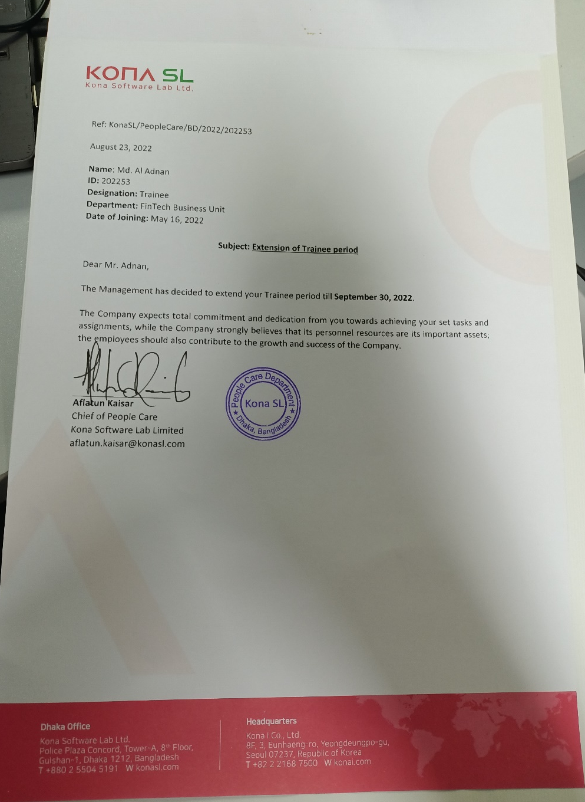
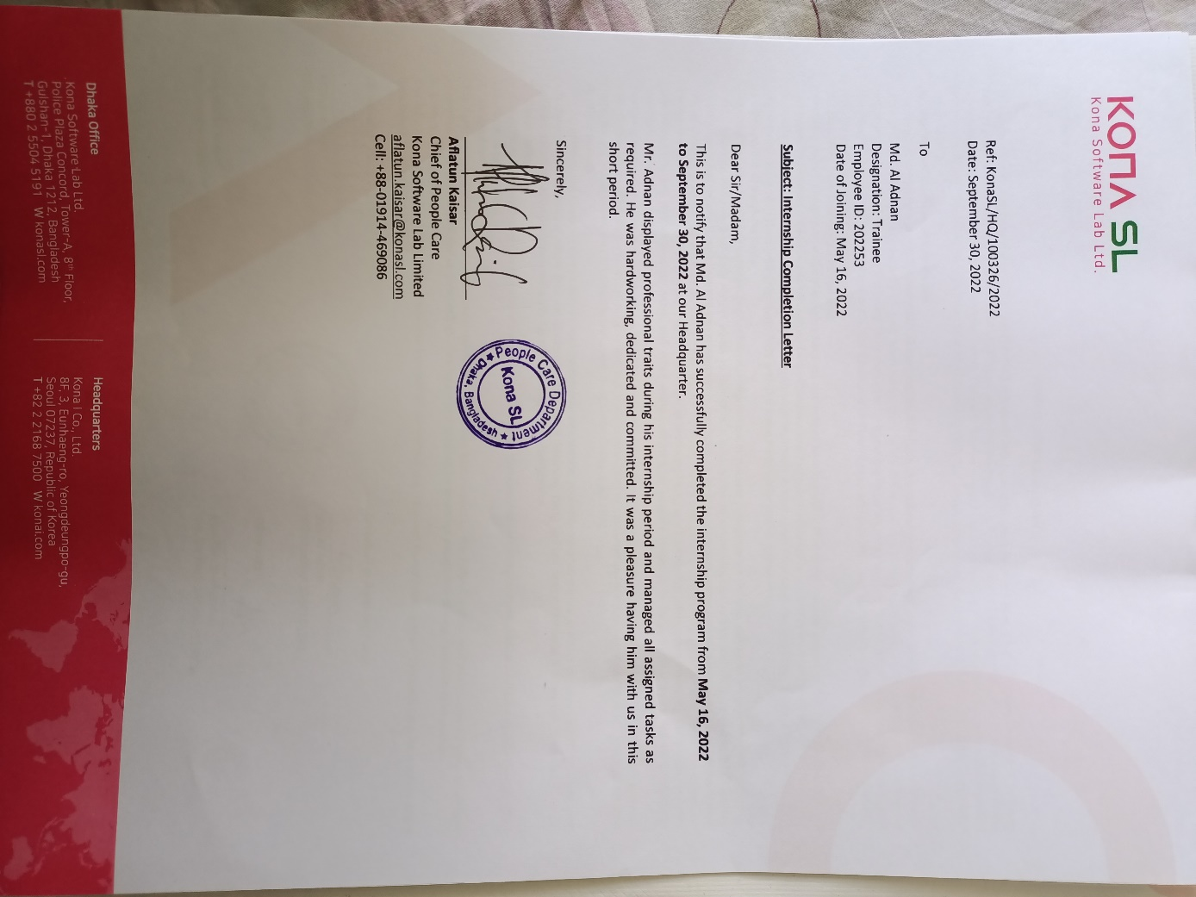
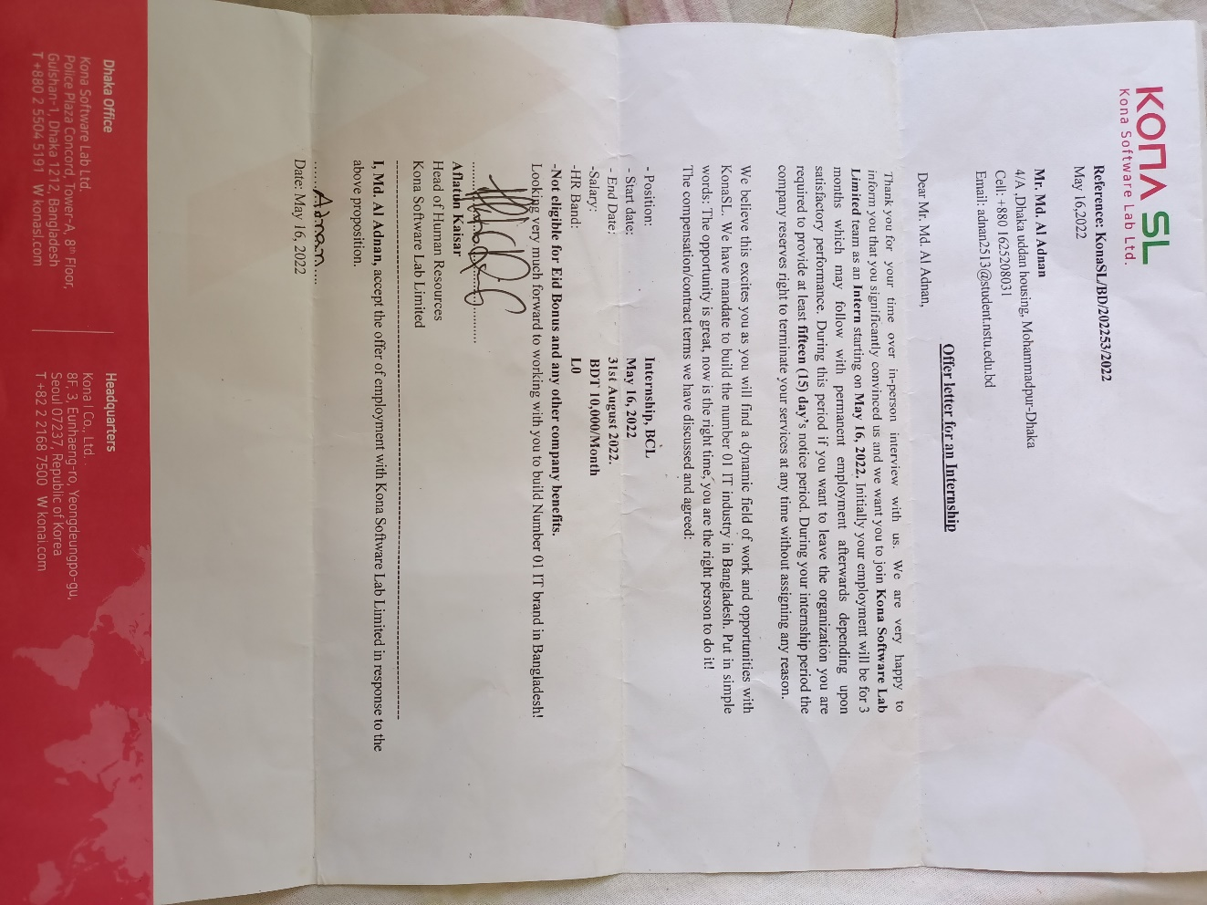
KONASL JOURNEY
Starting : 16-05-2022
Ending : 30-09-2022
Position: Software Engineer (Intern)
Business Unit: Fintech
Project: P2P

Slide 26
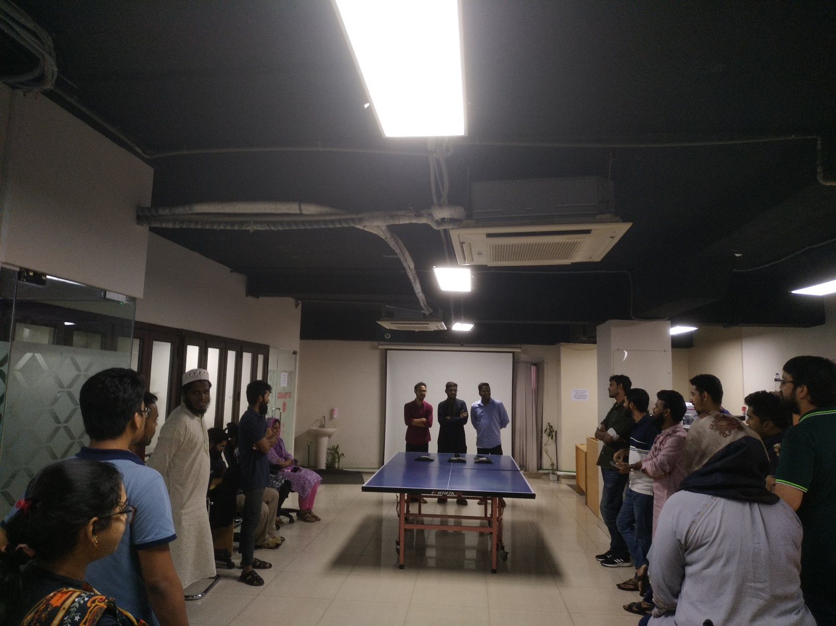
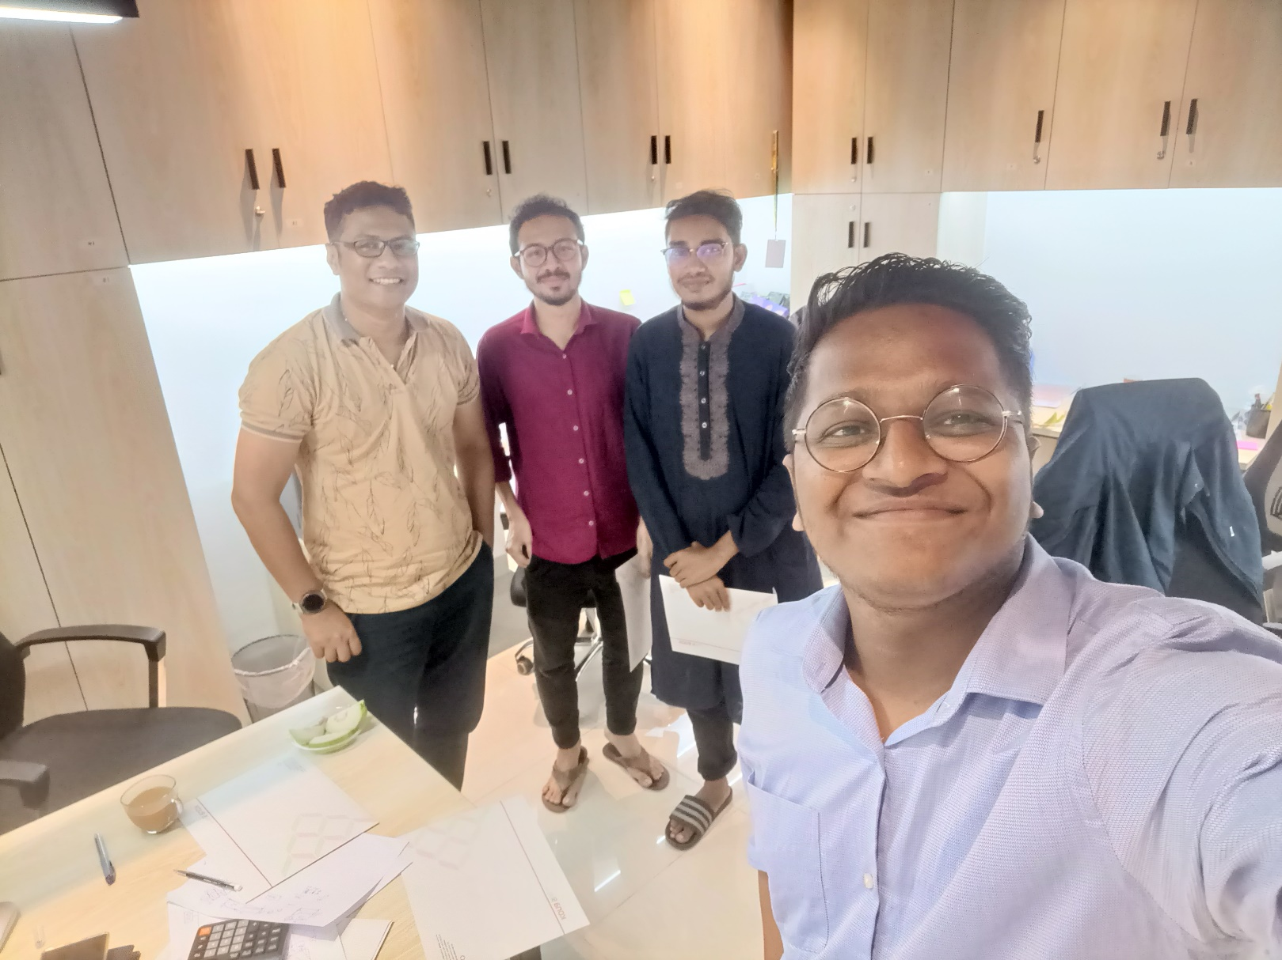
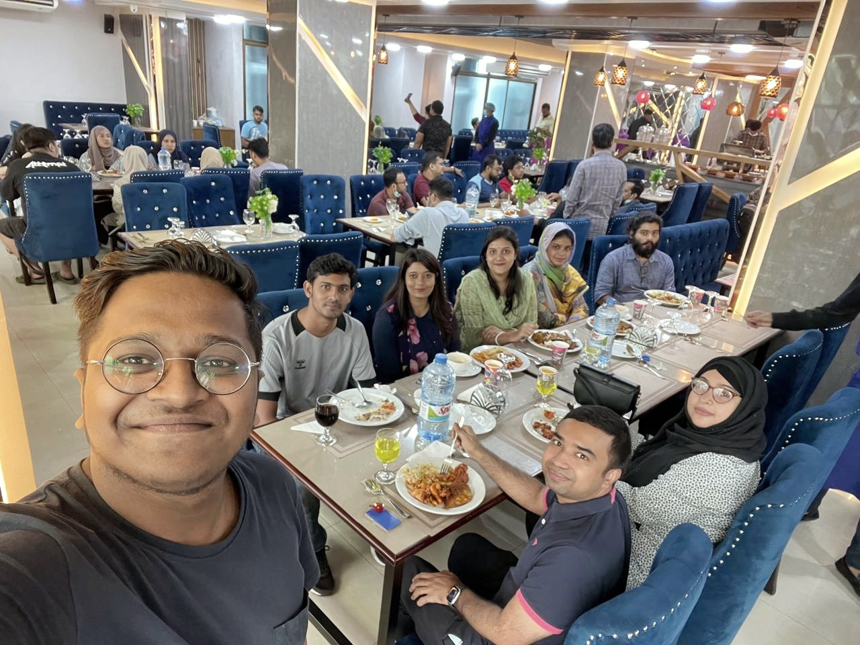
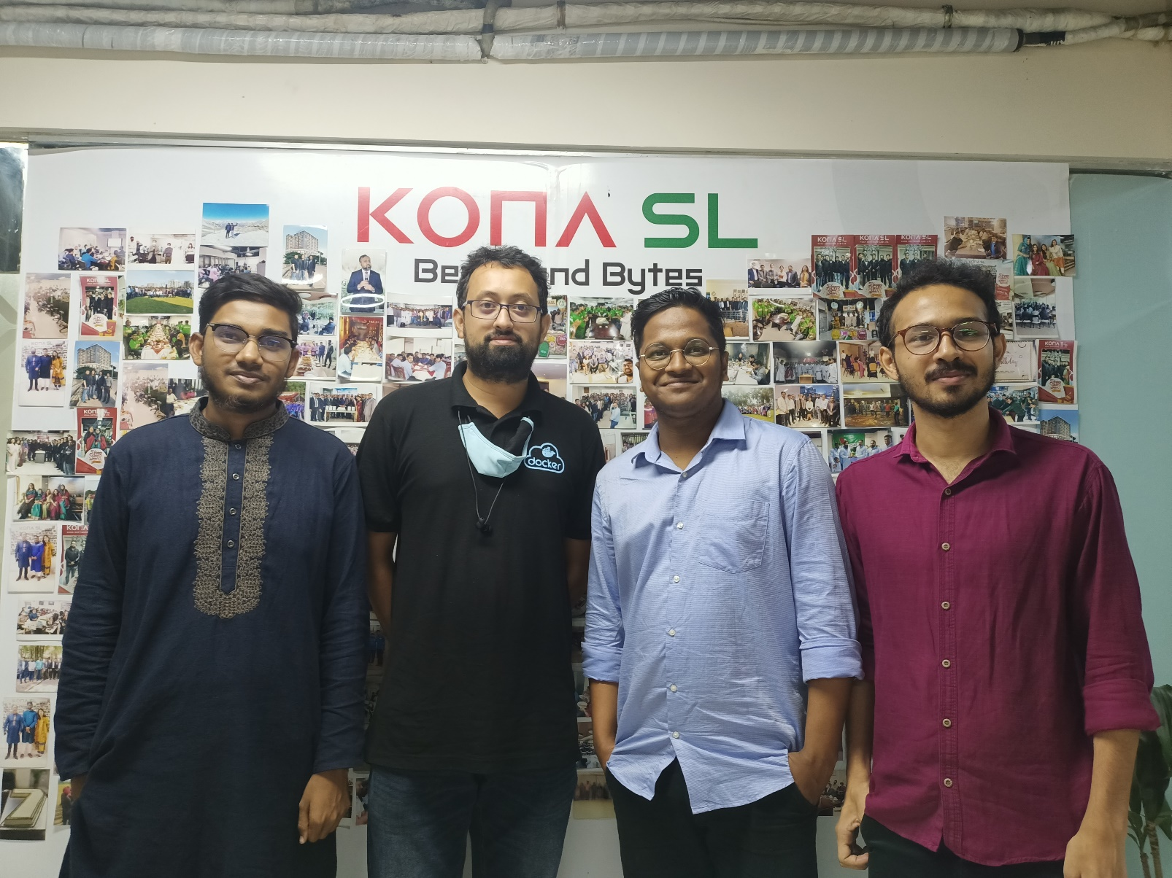
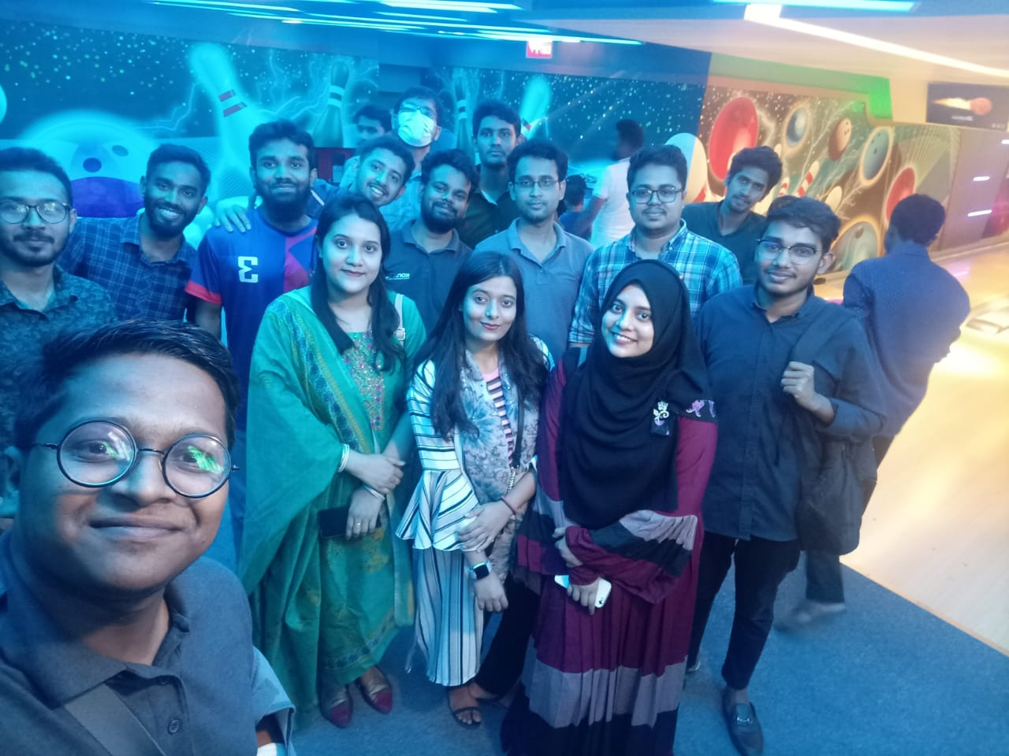
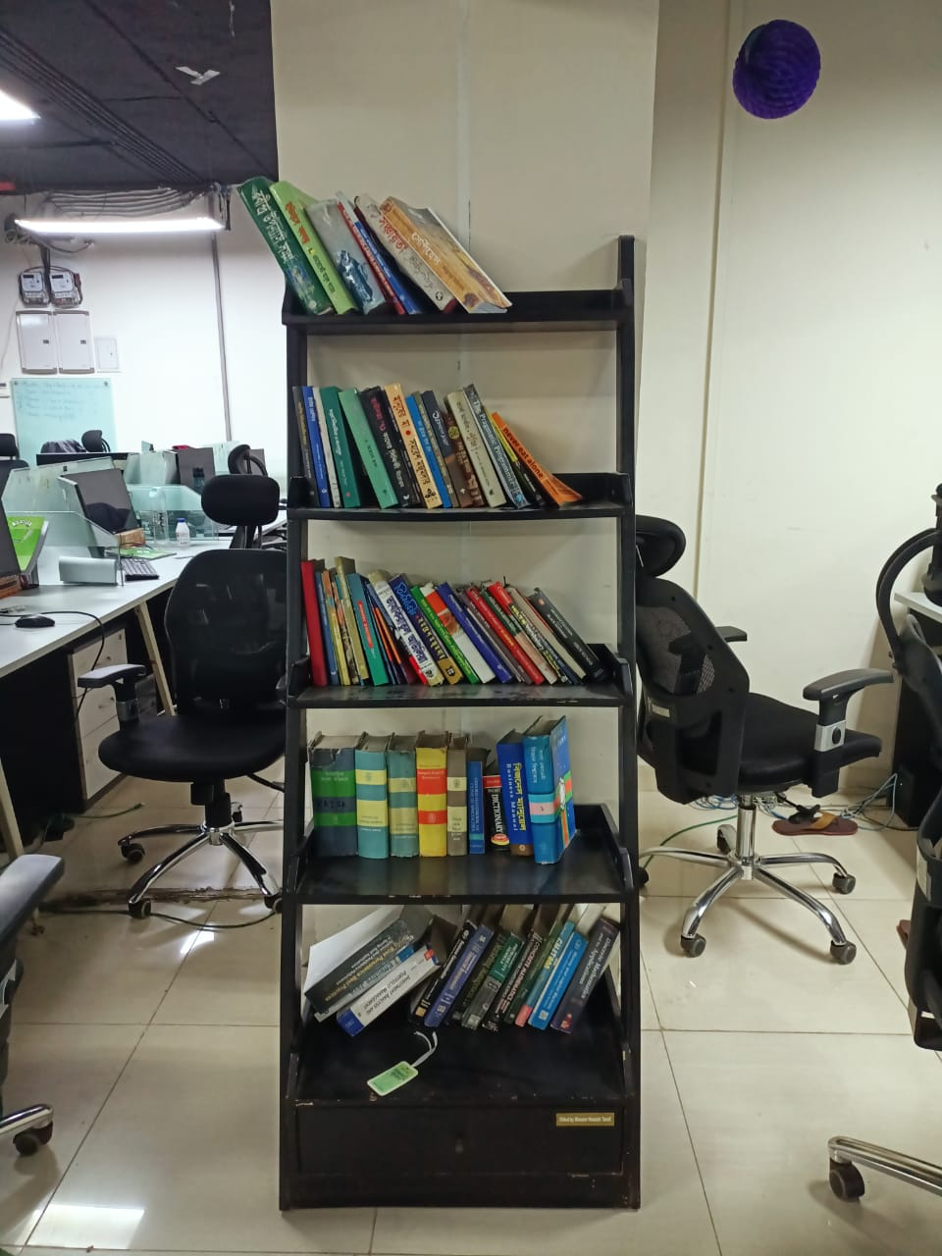
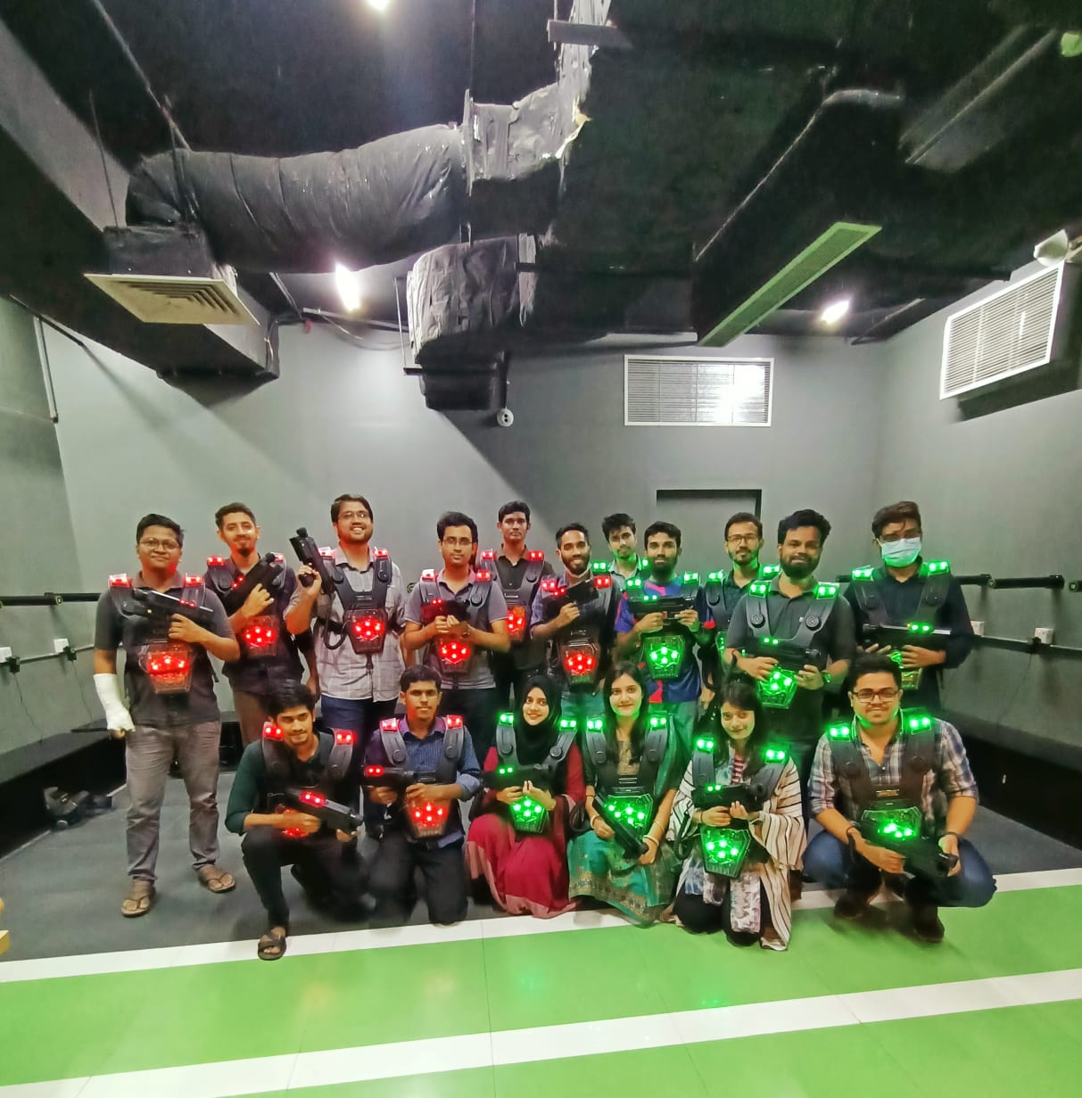
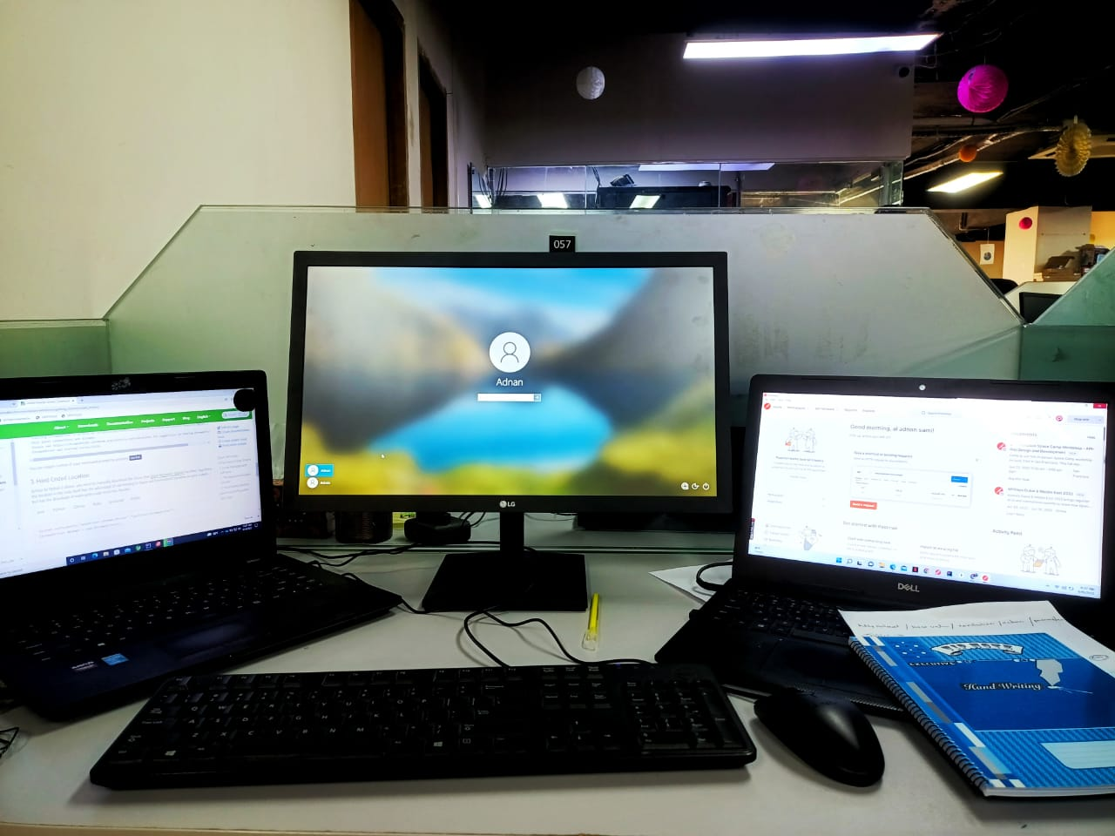
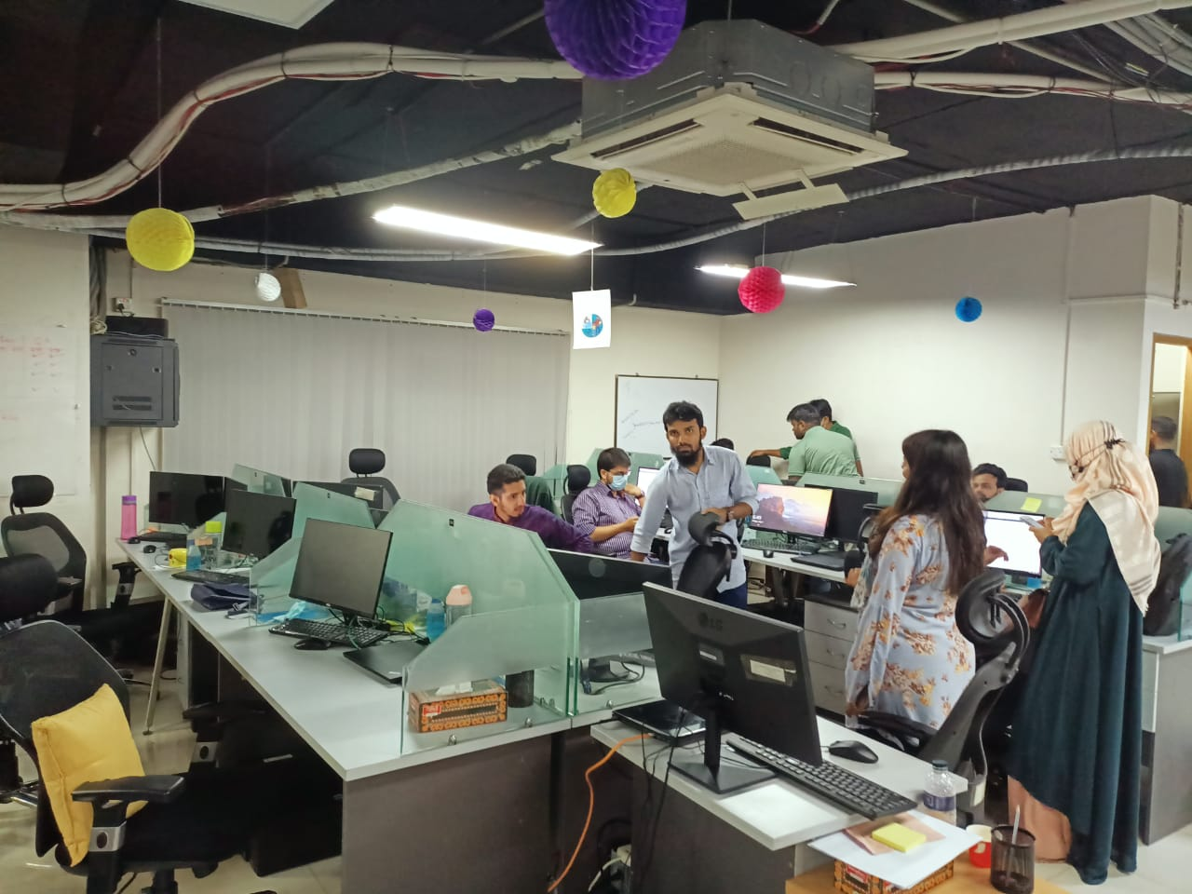
Office Environment

Slide 27

Challenges I have faced in new place
Transportation
Food
Meeting new colleagues
Fitting into the company culture
Maintaining work-life balance
Arrive early every day

Slide 28
What new skill I have learnt
Automation Testing In Selenium
Spring Boot
MongoDB
Jira Task Management
Log status read
JMeter(Load Test)
React Basic
Allure Report

Slide 29
Self Judgment about KONASL
Actually 4.5 months internship journey with KONASL was beyond my expectations. It is one of the best company in Bangladesh .
Friendly Work Environment.
Respect Employs emotion

Slide 30
Self Judgment about ME
I have performed up to the mark as company expected when they hired me for the internship. I had always tried to maintain the deadline of the tasks that were given to me and tried to provide best possible outcomes. Higher authority of the company and my supervisor was satisfied.

Slide 31


